Slide 1
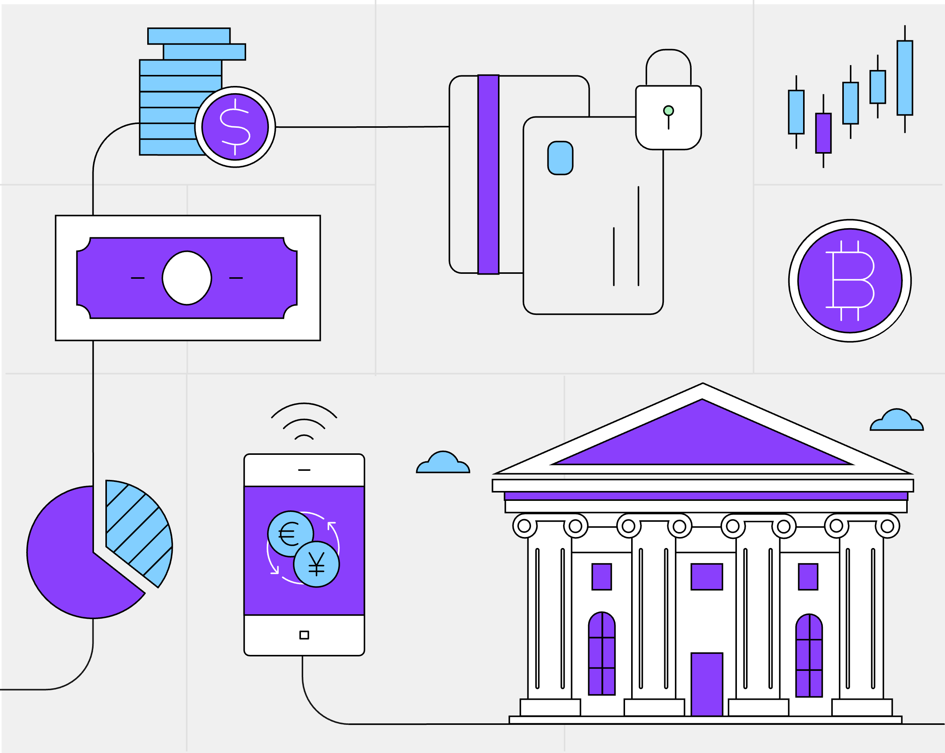
Banking & Financial Markets
November 2023

Slide 2




IBM Institute for Business Value usage guidelines
The IBM Institute for Business Value (IBM IBV) delivers fact-based technology and business insights.
This presentation:
Is for IBM internal use only.
Can be used for education and learning and building eminence for yourself and IBM.
Can be used to present to IBM audiences.
Cannot be left with customers in hard or soft copy.
Do not share this deck on slide sharing platforms with—or generally distribute to—undefined audiences.
Protect IBM intellectual capital and assets
http://ibm.com/ibv
©
If you have any questions regarding use of this document, please contact: IBV@us.ibm.com
References for each slide can be found in the speaker's notes as well as at the end of the presentation.

Slide 3
Table of Contents
Banking & Financial Markets Primer
Industry definition and activities | 04
Industry overview | 08
Industry dynamics | 09
Industry trends | 13
Technologies | 16
Strategic imperatives | 21
IBM capabilities | 22
Appendices
Generative AI | 24
Hybrid cloud | 26
Cybersecurity | 27
Open innovation & ecosystem | 28
KPIs & industry benchmarks | 29
Component business model | 31
Educational resources
Thought leadership | 33
Supplementary resources | 34
References | 35

Slide 4
Back to contents
Industry definition & activities
Banking institutions
Banking institutions primarily focus on intermediation of financial contracts. This involves accepting deposits, lending (e.g., personal or corporate lending, mortgages), processing payments, selling financial contracts to retail and affluent clients.
Financial Market institutions
Financial Market institutions do not have a banking license for deposit taking and lending activities. They assist issuers of financial products (e.g., corporates, governments, other banks) to receive capital from to investors (e.g., families, pension funds, investment funds, hedge funds) and manage financial risks.
Banking and Financial Markets are often overlapping concepts. The distinction here presented is adopted by IBM.
Primary Revenue Streams
Primary Revenue Streams
Interest rate margins the difference earned between the interest rate at which banks lend and the rate they pay on deposits.
Fees charges paid by customers for specific financial services. For example, clients pay fees for card transactions and direct money transfers, as well as buying investment products.
Fees charges paid by customers for specific financial services. For example, institutional and corporate clients pay fees for issuing investment products, buying investment products, receiving M&A advice.

Slide 5
Back to contents
Industry definition & activities
Player | Primary Purpose | Examples | Activities
Retail Banks | They provide financial services to individuals and small businesses. | Retail banking at JPMorgan Chase, BBVA, DBS, Mizuho, Ally Bank, Navy Federal Credit Union, Chime | Deposits and Savings Loans and Credit Services Investment products
Wholesale Banks | They provide financial services to governments, large corporations, and other financial institutions. | Corporate banking at Citi, HSBC, BBVA, Unicredit, DBS. | Corporate Financing Treasury Services M&A Advice Trade Finance
Payment Providers | They facilitate transactions and money transfers between individuals and businesses. | Amex, Mastercard, PayPal, Nexi, Paytm, Square, Stripe. | Payment Processing Money Transfer POS Solutions
Banking

Slide 6
Back to contents
Industry definition & activities
Player | Primary Purpose | Examples | Activities
Investment Management | They sell investment funds or manage investment portfolios on behalf of other firms. | BlackRock, Vanguard, Amundi, Blackstone, Bridgewater Associates | Portfolio Management Asset Allocation Risk Management
Wealth Management | They provide financial advice and services to high-net-worth individuals and families. | Morgan Stanley Wealth Management, UBS Wealth Management, Goldman Sachs Private Wealth Management, J.P. Morgan Private Bank | Financial Planning Advisory Services Estate Planning Charitable Giving
Exchanges | They provide a platform for buying and selling of financial instruments like stocks, bonds, and commodities. | New York Stock Exchange (NYSE), NASDAQ, Chicago Mercantile Exchange (CME), London Metal Exchange (LME) | Trading Platform Operations Listing Services Regulatory Compliance
Investment Banks and Capital Market firms | They provide services such as trading and market making, advice for mergers and acquisitions (M&A), capital raising. | Goldman Sachs Investment Banking, J.P. Morgan M&A Advisory, Morgan Stanley Corporate Finance, Barclays Investment Bank | Corporate Finance Advisory Services Underwriting Sales and Trading Research and Analysis
Financial Markets

Slide 7
Back to contents
Industry definition & activities
Player | Primary Purpose | Examples | Activities
Central banks | They are responsible for overseeing monetary policies (e.g. interest rate setting), managing inflation, and money supply. | Federal Reserve (USA), European Central Bank (ECB), Bank of Japan (BOJ), Bank of England (BoE), Bank of China (BOC) | Currency Issuance Reserve Management Monetary Policy Formulation
Regulatory Authorities | They enforce financial laws and oversee regulations to ensure market integrity and protect consumers. | U.S. Securities and Exchange Commission (SEC), Financial Conduct Authority (FCA) (UK), Australian Prudential Regulation Authority (APRA), China Banking Regulatory Commission (CBRC) | Bank prudential supervision Market surveillance Investors’ protection Compliance oversight Regulation setting and enforcement
Technology Services | This includes software applications, networks, and platforms that provide essential functions common to all banks. | FIS, FINASTRA, Thought Machine (vault), Broadridge | Core Banking Solutions Payments Networks Data Security Risk Management etc.
Regulators and other institutions

Slide 8
Back to contents
Industry overview
Industry Dynamics
Macroeconomic indicators
Spiking inflation, bottoming / rising interest rates, reversal of monetary policies.
Higher rates strain businesses’ appetite to borrow and diminishes bond values.
Geopolitical uncertainties
Heightening financial risk across geographies and economic sectors impact customer needs and test value chains.
New competition
Clients’ digital adoption is intercepted by new players such as digital platforms, confining the operating space for traditional financial institutions.
Evolving risk, compliance, and regulations
Cybersecurity and cyber-resilience are challenged by tech-advanced rogue players.
Increasing risk of ecosystem vitality due to digital connectivity.
Industry Trends
Business model innovation
Digital business models expand beyond banking.
Business and IT collaboration is mission critical for flexible and agile business models to succeed.
Core modernization and optimization
Prioritize cost reduction and modernization to build healthier operating models.
Realize efficiency gains from investments in cloud, data, and AI transforming ways of working.
Sustainability
Integrate sustainability into bank business strategies and operations.
Structure suitability-related products and selling to clients.
Technologies
2023 CEO study: Technologies expected to deliver results in banking and financial markets over the next three years¹
Strategic Imperatives
Prioritize growth and performance
Digital capabilities for operational resilience leads to healthier financial performance.
Engage ecosystem of partners and reset operating models on flexible architectures.
Align organizational incentives on value delivered with digital strategy execution.
Rethink cost and efficiency
Employ cloud techniques to improve the performance of critical value streams.
Reduce the skills gap.
Embrace an entrepreneurial mindset.
Navigating the ESG conundrum
Enhance ESG reporting and data governance to meet regulatory requirements.
Share ESG performance with employees, customers, and stakeholders to boost reputation.
Cloud Computing
AI (NLP, chatbots, etc.)
Advanced analytics
Blockchain
IoT & connected devices
AI (Gen AI and ML)
Quantum computing
Notes:
Industry overview
2023 Chief Executive Officer Study. IBM. 2023. https://w3.ibm.com/services/lighthouse/spaces/view/banking-financial-markets/documents/203094?ref=203094_1246_File

Slide 9
Back to contents
Industry dynamics
Macroeconomic indicators
The rising interest rates, spiking inflation, shift in monetary policies, and recessionary fears have significant impact on banking revenue and the performance of financial markets.
The aftermath of COVID-19 pandemic and recent military escalations have caused global inflation spikes, leading governments to raise interest rates¹.
Raising interest rates leads to increased cost of borrowing, making businesses and citizens to rethink investments decisions, thereby taming inflation.
Federal Reserve, the central bank of US, raised interest rates 11 times between March 2022 to September 2023, invoking recessionary fears among businesses.²
For banks, higher interest rates reduce the demand for lending activity while it widens net interest margins (NIM) until deposit rates are reset. The value of bonds held gets lower, adding regulatory pressure to maintain additional capital reserve (E.g., CET1).³
For financial markets, higher interest rates tend to introduce higher price volatilities on capital markets.
9.1%
US CPI Inflation in June 2022, a 40-year high and well above the historically aimed target of 2%⁴
Related IBM publications for more insights:
2023 Global Outlook for Banking and Financial Markets
Notes:
Industry Dynamics
Why Is Inflation So High Right Now? Entrepreneur. 2023. https://entm.ag/cpZUUh
Tepper, Taylor and Benjamin Curry. Federal Funds Rate History 1990 to 2023. Forbes. 2023. https://www.forbes.com/advisor/investing/fed-funds-rate-history/
Ramamurthy, Shanker, John Duigenan, Paolo Sironi, Diane Connelly, and Connor Loessl. 2023 Global Outlook for Banking and Financial Markets. IBM. 2023. https://w3.ibm.com/services/lighthouse/documents/195084?ref=195084_1246_File
Duggan, Wayne and Michael Adams. September Fed Meeting: Interest Rates Are Put On Hold, One More Rate Hike Likely. Forbes. 2023. https://www.forbes.com/advisor/investing/fomc-meeting-federal-reserve/
Global Financial Stability Report. International Monetary Fund. 2023. https://www.imf.org/en/Publications/GFSR/Issues/2023/04/11/global-financial-stability-report-april-2023
Ibid
Ibid
Ramamurthy , Shanker, John Duigenan, Paolo Sironi, Diane Connelly, and Connor Loessl. Embedded finance: Creating the everywhere, everyday bank. IBM. 2023. https://w3.ibm.com/services/lighthouse/spaces/view/banking-financial-markets/documents/206716?ref=206716_1246_File
Ibid
Ibid
Ibid
Ibid
Ibid
2023 Chief Executive Officer Study. IBM. 2023. https://w3.ibm.com/services/lighthouse/spaces/view/banking-financial-markets/documents/203094?ref=203094_1246_File
Ibid
Ibid

Slide 10
Back to contents
Industry dynamics
Geopolitical uncertainties
Economic rivalry and deglobalization induced by geopolitical tensions impact the global financial stability. This affects the cross-border allocation of capital, the reliability of international payment systems (e.g., sanctions), and the dynamics of asset prices.
Geopolitical tensions may abruptly reverse capital flows, impacting emerging economies more than advanced ones.⁵
Military escalations may continue for an extended period, impacting the economic competitiveness of whole countries and beyond.
The business and commercial competition between two largest global economic powers—the US and China—could continue impacting investments and trade.
The shift from collaboration to open competition has been recognized worldwide and is causing the delicate repositioning of established strategies.
Governments are exploring deglobalization strategies to protect their economies from geopolitical risks, resulting in overall increase in prices and supply chain inefficiencies.⁶
15%
reduction in the overall bilateral cross-border allocation of portfolio investment and bank claims when tensions escalate between an investing and a recipient country, as seen in the case of the United States and China since 2016⁷
Related IBM publications for more insights:
2023 Global Outlook for Banking and Financial Markets
Notes:
Industry Dynamics
Why Is Inflation So High Right Now? Entrepreneur. 2023. https://entm.ag/cpZUUh
Tepper, Taylor and Benjamin Curry. Federal Funds Rate History 1990 to 2023. Forbes. 2023. https://www.forbes.com/advisor/investing/fed-funds-rate-history/
Ramamurthy, Shanker, John Duigenan, Paolo Sironi, Diane Connelly, and Connor Loessl. 2023 Global Outlook for Banking and Financial Markets. IBM. 2023. https://w3.ibm.com/services/lighthouse/documents/195084?ref=195084_1246_File
Duggan, Wayne and Michael Adams. September Fed Meeting: Interest Rates Are Put On Hold, One More Rate Hike Likely. Forbes. 2023. https://www.forbes.com/advisor/investing/fomc-meeting-federal-reserve/
Global Financial Stability Report. International Monetary Fund. 2023. https://www.imf.org/en/Publications/GFSR/Issues/2023/04/11/global-financial-stability-report-april-2023
Ibid
Ibid
Ramamurthy , Shanker, John Duigenan, Paolo Sironi, Diane Connelly, and Connor Loessl. Embedded finance: Creating the everywhere, everyday bank. IBM. 2023. https://w3.ibm.com/services/lighthouse/spaces/view/banking-financial-markets/documents/206716?ref=206716_1246_File
Ibid
Ibid
Ibid
Ibid
Ibid
2023 Chief Executive Officer Study. IBM. 2023. https://w3.ibm.com/services/lighthouse/spaces/view/banking-financial-markets/documents/203094?ref=203094_1246_File
Ibid
Ibid

Slide 11
Back to contents
Industry dynamics
New competition
The accelerating digital adoption of customers has been intercepted by more agile and tech-advanced competitors, challenging traditional financial institutions.
The pandemic made customers more accustomed to digital financial services, exposing the shortcomings of traditional business propositions.
Across all ages and markets, nearly 80% of customers favor online access for virtually all basic transactions. And 16% are already comfortable with a branchless, fully digital proposition to deposit their salary.⁸
Incumbents are hindered by legacy IT and business models that are not modular.
The new competitors are a mix of fintech startups and “techfin” organizations (technology companies in financial arena) that woo clients with a better customer experience at a lower cost.⁹
Offering a better client experience is inextricably linked with offering a better employee experience. With more digital competitors wooing top talent, banks need to address the human side of operating models as part of a combined automation and augmentation effort.¹⁰
300
approximate number of digital-first banks existing worldwide¹¹
The rise of the platform economy¹²
Technology and tech enabled companies consistently outperform their peers
Related IBM publications for more insights:
2023 Global Outlook for Banking and Financial Markets
Embedded finance: Creating the everywhere, everyday bank
Notes:
Industry Dynamics
Why Is Inflation So High Right Now? Entrepreneur. 2023. https://entm.ag/cpZUUh
Tepper, Taylor and Benjamin Curry. Federal Funds Rate History 1990 to 2023. Forbes. 2023. https://www.forbes.com/advisor/investing/fed-funds-rate-history/
Ramamurthy, Shanker, John Duigenan, Paolo Sironi, Diane Connelly, and Connor Loessl. 2023 Global Outlook for Banking and Financial Markets. IBM. 2023. https://w3.ibm.com/services/lighthouse/documents/195084?ref=195084_1246_File
Duggan, Wayne and Michael Adams. September Fed Meeting: Interest Rates Are Put On Hold, One More Rate Hike Likely. Forbes. 2023. https://www.forbes.com/advisor/investing/fomc-meeting-federal-reserve/
Global Financial Stability Report. International Monetary Fund. 2023. https://www.imf.org/en/Publications/GFSR/Issues/2023/04/11/global-financial-stability-report-april-2023
Ibid
Ibid
Ramamurthy , Shanker, John Duigenan, Paolo Sironi, Diane Connelly, and Connor Loessl. Embedded finance: Creating the everywhere, everyday bank. IBM. 2023. https://w3.ibm.com/services/lighthouse/spaces/view/banking-financial-markets/documents/206716?ref=206716_1246_File
Ibid
Ibid
Ibid
Ibid
Ibid
2023 Chief Executive Officer Study. IBM. 2023. https://w3.ibm.com/services/lighthouse/spaces/view/banking-financial-markets/documents/203094?ref=203094_1246_File
Ibid
Ibid

Slide 12
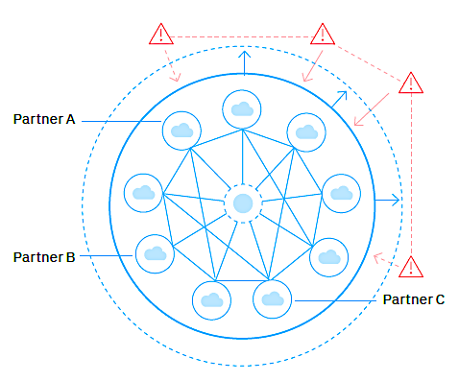
Back to contents
Industry dynamics
Evolving risk, compliance, and regulations
Embracing exponential technologies, new digital channels and ecosystems, along with innovative financial services like open banking and decentralized finance (DeFi), is making traditional practices for risk and compliance insufficient for digital future.
Financial institutions are realizing that risk awareness pays off and are viewing security investments as revenue enablers that improve operational resilience.
58% of banking and financial markets CEOs consider cybersecurity and data privacy among their top three priorities over the next three years.¹⁴
Holistic strategies to share and integrate customer data across security functions, to predict and respond proactively are essential in evolving risk landscape.
Shared resilience model, that enables multilateral coordination among ecosystem partners, reduces risk, and enables openness and value creation is gaining traction.
New regulatory requirements such as the upcoming Digital Operational Resilience Act (DORA) in the European Union also focuses on operational resilience to counter evolving risks in the digital era.¹⁶
Reliance on cloud hyper-scalers and growth in novel interdependencies prompt concerns of industry-wide operational stability.
2000
CIOs and CTOs of financial institutions globally defined “unified security frameworks”—spanning cyber risk to compliance postures—as their top priority to generate greater business value in the next three years¹³
Shared Resilience Model¹⁵
Related IBM publications for more insights:
2023 Global Outlook for Banking and Financial Markets
Notes:
Industry Dynamics
Why Is Inflation So High Right Now? Entrepreneur. 2023. https://entm.ag/cpZUUh
Tepper, Taylor and Benjamin Curry. Federal Funds Rate History 1990 to 2023. Forbes. 2023. https://www.forbes.com/advisor/investing/fed-funds-rate-history/
Ramamurthy, Shanker, John Duigenan, Paolo Sironi, Diane Connelly, and Connor Loessl. 2023 Global Outlook for Banking and Financial Markets. IBM. 2023. https://w3.ibm.com/services/lighthouse/documents/195084?ref=195084_1246_File
Duggan, Wayne and Michael Adams. September Fed Meeting: Interest Rates Are Put On Hold, One More Rate Hike Likely. Forbes. 2023. https://www.forbes.com/advisor/investing/fomc-meeting-federal-reserve/
Global Financial Stability Report. International Monetary Fund. 2023. https://www.imf.org/en/Publications/GFSR/Issues/2023/04/11/global-financial-stability-report-april-2023
Ibid
Ibid
Ramamurthy , Shanker, John Duigenan, Paolo Sironi, Diane Connelly, and Connor Loessl. Embedded finance: Creating the everywhere, everyday bank. IBM. 2023. https://w3.ibm.com/services/lighthouse/spaces/view/banking-financial-markets/documents/206716?ref=206716_1246_File
Ibid
Ibid
Ibid
Ibid
Ibid
2023 Chief Executive Officer Study. IBM. 2023. https://w3.ibm.com/services/lighthouse/spaces/view/banking-financial-markets/documents/203094?ref=203094_1246_File
Ibid
Ibid

Slide 13
Back to contents
Industry trends
Business model innovation
Large traditional institutions are hindered by less agile legacy business and operating models. Many of these models were designed in another era for another era, long before the emergence of agility enabled by exponential technologies.
The distance between current business models and unexploited digital opportunities is reflected in dropping price-to-book ratio (PBR), stressed net interest margins (NIM), and poor return on average equity (ROAE).³
Incumbents need to drive growth and performance in a sector rife with new, nimble, digital competitors who are rewriting the rules of engagement.
Financial institutions should shift from siloed innovation within the confines of traditional industry definitions to a holistic strategy to rapidly create digital business models beyond banking, utilizing emerging technologies.
Ecosystem platforms can multiply value when financial institutions focus on redesigning customer engagement, improving business and IT collaboration, and enable sharing data, insights, and capabilities with trusted partners.⁴
Consumer industry, Manufacturing/Industrial products, Healthcare, Education, and Telecommunications are the areas where bankers see greatest potential to elevate their role.⁵
14.05% to 6.09%
drop in the median of the five-year average ROAE for the top 50 banks (by total assets) for major advanced economies (as defined by the International Monetary Fund) and EU member states¹
Industry Trends are some of the observable changes that are reshaping banking and financial markets industry, in response to the dynamics.
57%
of executives say banks can get the most value from directly orchestrating retail- or small-to-medium enterprise (SME)-oriented ecosystems.²
Related IBM publications for more insights:
2023 Global Outlook for Banking and Financial Markets
Embedded finance: Creating the everywhere, everyday bank
Notes:
Industry Trends
Ramamurthy, Shanker, John Duigenan, Paolo Sironi, Diane Connelly, and Connor Loessl. 2023 Global Outlook for Banking and Financial Markets. IBM. 2023. https://w3.ibm.com/services/lighthouse/documents/195084?ref=195084_1246_File
Ramamurthy, Shanker, John Duigenan, Paolo Sironi, Diane Connelly, and Connor Loessl. Embedded finance: Creating the everywhere, everyday bank. IBM. 2023. https://w3.ibm.com/services/lighthouse/spaces/view/banking-financial-markets/documents/206716?ref=206716_1246_File
Ibid
Ibid
Ibid
Ibid
Ibid
Ibid
Ibid
Ibid
2023 Chief Executive Officer Study. IBM. 2023. https://w3.ibm.com/services/lighthouse/spaces/view/banking-financial-markets/documents/203094?ref=203094_1246_File
Green Investment – the Uncertain Future of Sustainable Bonds in 2023. Bloomberg. 2023. https://www.bloomberg.com/professional/blog/webinar/green-investment-is-the-greenium-alive-and-well-in-2023/
Pathways in transformative sustainability: banking CEOs own their impact. IBM. 2022. https://www.ibm.com/thought-leadership/institute-business-value/en-us/blog/pathways-sustainability-banking-ceos
ESG reporting and performance (2023). IBM. 2023. https://w3.ibm.com/services/bcs/competency/benchmarking/wizard/protect/bmwizard.wss/showResultsPage2?functionId=53651
Ibid
Ibid

Slide 14
Back to contents
Industry trends
Core modernization and optimization
To build healthy and resilient operating models, leaders must address legacy architectures, costs, and business culture.
Cost reduction and optimization is crucial to free capital for new investments, especially since cost-to-income ratio (CIR), which measure a bank’s efficiency, remain underwhelming.
Monolithic core banking architectures increase costs and delay the value that digitalization or consolidations could bring.⁶
During cost and efficiency optimization initiatives, financial institutions should take a proactive and long-term approach that includes eliminating products that no longer align with firm’s overarching strategy and redesigning processes using AI and automation.⁷
A collaborative and long-term approach that enables financial institutions to realize cost and efficiency gains from their cloud, automation, and AI investments helps increase customer experience, return-on-equity (ROE), and reduce CIR.
Total estimated technology spending in retail banking in 2022 is around $250 billion.⁸
Only 43% of IT executives in the US say they have visibility into costs and consumption across their cloud environment, making bankers to realize the importance of involving business, IT, and other functions in cost and efficiency optimization initiatives.⁹
59%
Cost-to-income ratio (CIR) in major advanced economies and EU member states¹⁰
47% of banking and financial markets CEOs consider tech modernization among their top three priorities over the next three years¹¹
Related IBM publications for more insights:
2023 Global Outlook for Banking and Financial Markets
Embedded finance: Creating the everywhere, everyday bank
Notes:
Industry Trends
Ramamurthy, Shanker, John Duigenan, Paolo Sironi, Diane Connelly, and Connor Loessl. 2023 Global Outlook for Banking and Financial Markets. IBM. 2023. https://w3.ibm.com/services/lighthouse/documents/195084?ref=195084_1246_File
Ramamurthy, Shanker, John Duigenan, Paolo Sironi, Diane Connelly, and Connor Loessl. Embedded finance: Creating the everywhere, everyday bank. IBM. 2023. https://w3.ibm.com/services/lighthouse/spaces/view/banking-financial-markets/documents/206716?ref=206716_1246_File
Ibid
Ibid
Ibid
Ibid
Ibid
Ibid
Ibid
Ibid
2023 Chief Executive Officer Study. IBM. 2023. https://w3.ibm.com/services/lighthouse/spaces/view/banking-financial-markets/documents/203094?ref=203094_1246_File
Green Investment – the Uncertain Future of Sustainable Bonds in 2023. Bloomberg. 2023. https://www.bloomberg.com/professional/blog/webinar/green-investment-is-the-greenium-alive-and-well-in-2023/
Pathways in transformative sustainability: banking CEOs own their impact. IBM. 2022. https://www.ibm.com/thought-leadership/institute-business-value/en-us/blog/pathways-sustainability-banking-ceos
ESG reporting and performance (2023). IBM. 2023. https://w3.ibm.com/services/bcs/competency/benchmarking/wizard/protect/bmwizard.wss/showResultsPage2?functionId=53651
Ibid
Ibid

Slide 15
Back to contents
Industry trends
$1525 B
global sustainable debt issuance in 2022 in the form of green bond, sustainability bond, sustainability linked loan, and many more¹²
Sustainability
Environmental concerns have led to new, albeit necessary, restrictions on business and economic activities. While banks can be an integral part of the sustainability solution and find new revenue opportunities, they are also exposed to new risks and complex compliance requirements.
Financial institutions hold the keys to unlocking sustainability within their own operations and across industries. 71% executives state that ESG objectives are central to their business strategy.^{13,14}
Issuing loans, bonds, or credit for sustainability products, offering rewards for purchase of sustainable goods using commercial cards, investing deposits in sustainable assets are a few ways for financial institutions to promote responsible finance practices.
Exponential technologies like data, AI, and the cloud play a key role in measuring and embedding sustainability into standard operations, contributing to sustainability goals.
Advanced analytics, automation, and cloud are the top three technologies that financial institutions use to advance in ESG.¹⁵
42% executives in financial institutions state inadequate data as biggest challenge in achieving sustainability objectives, and technology play a key role in solving the same.¹⁶
Related IBM publications for more insights:
2023 Global Outlook for Banking and Financial Markets
Notes:
Industry Trends
Ramamurthy, Shanker, John Duigenan, Paolo Sironi, Diane Connelly, and Connor Loessl. 2023 Global Outlook for Banking and Financial Markets. IBM. 2023. https://w3.ibm.com/services/lighthouse/documents/195084?ref=195084_1246_File
Ramamurthy, Shanker, John Duigenan, Paolo Sironi, Diane Connelly, and Connor Loessl. Embedded finance: Creating the everywhere, everyday bank. IBM. 2023. https://w3.ibm.com/services/lighthouse/spaces/view/banking-financial-markets/documents/206716?ref=206716_1246_File
Ibid
Ibid
Ibid
Ibid
Ibid
Ibid
Ibid
Ibid
2023 Chief Executive Officer Study. IBM. 2023. https://w3.ibm.com/services/lighthouse/spaces/view/banking-financial-markets/documents/203094?ref=203094_1246_File
Green Investment – the Uncertain Future of Sustainable Bonds in 2023. Bloomberg. 2023. https://www.bloomberg.com/professional/blog/webinar/green-investment-is-the-greenium-alive-and-well-in-2023/
Pathways in transformative sustainability: banking CEOs own their impact. IBM. 2022. https://www.ibm.com/thought-leadership/institute-business-value/en-us/blog/pathways-sustainability-banking-ceos
ESG reporting and performance (2023). IBM. 2023. https://w3.ibm.com/services/bcs/competency/benchmarking/wizard/protect/bmwizard.wss/showResultsPage2?functionId=53651
Ibid
Ibid

Slide 16
Back to contents
Technologies Artificial intelligence
Financial services landscape is rapidly evolving, pushing financial institutions to embrace AI and advanced analytics to stay competitive.
Traditional AI and advanced analytics can help financial institutions in fraud detection, automation, risk assessment, optimizing investment portfolios, and deriving insights from customer, operations and network data.
Generative AI can transform customer experience by enabling personalized and simplified interactions through virtual agents or chatbots across multiple channels.
Human resources, ESG, risk and compliance, and cybersecurity are few additional areas where AI and advanced analytics would play a key role in reducing costs and improving efficiency.
AI introduces new risks associated with the use of algorithms, including ethical concerns. To address these issues, most organizations are establishing a governance structure that includes policies and standards.
Modernize customer care (VAT, AI)
Modernize credit risk evaluation (AI)
78%
Overall reach of execs prioritizing a combination of these 4 AI-driven initiatives
Modernize workforce engagement (AI)
Modernize financial crime (AI)
Modernize/automate account opening
Modernize/automate trade finance docs
Modernize payments
Modernize/automate credit applications
Modernize/automate loan management
Overall reach of bankers recognize the role of AI in prioritizing a combination of these four end to end modernization initiatives¹
Related IBM publications for more insights:
Foundations of banking excellence
Generative AI: “State of the Enterprise Market”
Click here to go to Generative AI section in appendices
Notes:
Technologies
Ramamurthy, Shanker, John Duigenan, Paolo Sironi, and Diane Connelly. Foundations of banking excellence: Practices and priorities to accelerate digital transformation. IBM. 2022. https://w3.ibm.com/services/lighthouse/spaces/view/banking-financial-markets/documents/190607?ref=190607_1246_File
Ibid
Ibid
Ibid
Chief data officer study. IBM. 2023. https://w3.ibm.com/services/bcs/competency/benchmarking/wizard/protect/bmwizard.wss/showCoverPage2?pageType=2&refId=53558
The Benefits of the Blockchain in Financial Services: Modern Solutions and Examples. Coinpedia. 2023. https://coinpedia.org/guest-post/benefits-of-blockchain-in-financial-services-modern-solutions-and-examples/
Swift unlocks potential of tokenisation with successful blockchain experiments. SWIFT. 2023. https://www.swift.com/news-events/press-releases/swift-unlocks-potential-tokenisation-successful-blockchain-experiments
6 Ways the IoT is Revolutionizing the Banking and Investment Sector. AIIOT. 2023. https://www.aiiottalk.com/iot-revolutionizing-the-banking-and-investment-sector/
2023 Chief Executive Officer Study. IBM. 2023. https://w3.ibm.com/services/lighthouse/spaces/view/banking-financial-markets/documents/203094?ref=203094_1246_File
Egger, Daniel, Paolo Sironi, Richard Warrick, and Stefan Worner. Exploring quantum computing use cases for financial services: Applying emerging quantum technology to financial problems. IBM. 2019. https://w3.ibm.com/services/lighthouse/documents/145398?ref=145398_1246_File
Quantum use case. IBM. 2023. https://ibm.seismic.com/Link/Content/DC9dpHCVH3mGpGcDcb8h9G3W9VJd
Quantum readiness. IBM. 2023. https://w3.ibm.com/services/bcs/competency/benchmarking/wizard/protect/bmwizard.wss/showCoverPage2?pageType=2&refId=54250
Ibid
Ibid
Ibid
Ibid
Ibid

Slide 17
Back to contents
Technologies Hybrid cloud
Hybrid cloud is a “must have” for transforming of financial institutions’ business architectures from monolithic, inflexible, complex, and expensive setups to open, modular, agile, and automated design.³
Bank executives anticipate an upward trend towards hybrid cloud, which can help improve the languishing financial measures, cost-to-income ratio (CIR) and return on equity (ROE).⁴
Mastering hybrid cloud means improving financial institutions’ cybersecurity posture, solves the architectural challenges related to scaling and partnerships, increases employee productivity, and optimizes IT costs.
Embedding financial services into the user ecosystems of other industries using cloud speeds up the launch of customer-centric business models and enables interoperability of data among partners.
62% of chief data officers in financial institutions are utilizing hybrid cloud to unlock value from data to a large extent.⁵
Bank executives anticipate an upward trend toward hybrid cloud²
72%
67%
^
7 %
28%
33%
^
18%
2022
2025
2022
2023
Monolithic private, or public
Hybrid cloud
Related IBM publications for more insights:
Foundations of banking excellence
Mastering hybrid cloud
Notes:
Technologies
Ramamurthy, Shanker, John Duigenan, Paolo Sironi, and Diane Connelly. Foundations of banking excellence: Practices and priorities to accelerate digital transformation. IBM. 2022. https://w3.ibm.com/services/lighthouse/spaces/view/banking-financial-markets/documents/190607?ref=190607_1246_File
Ibid
Ibid
Ibid
Chief data officer study. IBM. 2023. https://w3.ibm.com/services/bcs/competency/benchmarking/wizard/protect/bmwizard.wss/showCoverPage2?pageType=2&refId=53558
The Benefits of the Blockchain in Financial Services: Modern Solutions and Examples. Coinpedia. 2023. https://coinpedia.org/guest-post/benefits-of-blockchain-in-financial-services-modern-solutions-and-examples/
Swift unlocks potential of tokenisation with successful blockchain experiments. SWIFT. 2023. https://www.swift.com/news-events/press-releases/swift-unlocks-potential-tokenisation-successful-blockchain-experiments
6 Ways the IoT is Revolutionizing the Banking and Investment Sector. AIIOT. 2023. https://www.aiiottalk.com/iot-revolutionizing-the-banking-and-investment-sector/
2023 Chief Executive Officer Study. IBM. 2023. https://w3.ibm.com/services/lighthouse/spaces/view/banking-financial-markets/documents/203094?ref=203094_1246_File
Egger, Daniel, Paolo Sironi, Richard Warrick, and Stefan Worner. Exploring quantum computing use cases for financial services: Applying emerging quantum technology to financial problems. IBM. 2019. https://w3.ibm.com/services/lighthouse/documents/145398?ref=145398_1246_File
Quantum use case. IBM. 2023. https://ibm.seismic.com/Link/Content/DC9dpHCVH3mGpGcDcb8h9G3W9VJd
Quantum readiness. IBM. 2023. https://w3.ibm.com/services/bcs/competency/benchmarking/wizard/protect/bmwizard.wss/showCoverPage2?pageType=2&refId=54250
Ibid
Ibid
Ibid
Ibid
Ibid

Slide 18
Back to contents
Technologies Blockchain & IoT
IoT generates valuable data but has security vulnerabilities, while blockchain offers strong security but needs extensive data. Combining them complements their strengths and weaknesses.
Blockchain offers a secure, tamper-proof and immutable ledger, making it ideal for storing sensitive financial data, while promoting transparency.
Blockchain provides financial institutions with benefits such as peer-to-peer cryptocurrency transfers, trust-enhancing smart contracts for lending and borrowing, cost optimization through the elimination of settlement and clearing, regulatory verifications, and faster cross-border payments.⁶
Swift conducted experiments with ANZ, Citi, BNY, and several other banks to demonstrate blockchain interoperability, that is to connect multiple blockchains for movement of tokenized assets around the world is achievable.⁷
IoT devices can collect real-time customer data and behavior patterns in ATMs and banks that can be utilized to optimize processes.
Contactless NFC based payments through IoT devices, and providing better insights related to customer risk profile during lending activities are few more areas where IoT technology can help financial institutions.⁸
Technologies expected to help deliver results over the next three years⁹
Cloud computing (public, private, hybrid)
56%
AI (NLP, chatbots, etc.)
56%
Advanced analytics
50%
Blockchain
49%
IOT & Connected Devices
49%
AI (generative AI, DL, ML)
40%
Automation (incl. RPA)
27%
Quantum computing
19%
Related IBM publications for more insights:
2023 Chief Executive Officer Study
Notes:
Technologies
Ramamurthy, Shanker, John Duigenan, Paolo Sironi, and Diane Connelly. Foundations of banking excellence: Practices and priorities to accelerate digital transformation. IBM. 2022. https://w3.ibm.com/services/lighthouse/spaces/view/banking-financial-markets/documents/190607?ref=190607_1246_File
Ibid
Ibid
Ibid
Chief data officer study. IBM. 2023. https://w3.ibm.com/services/bcs/competency/benchmarking/wizard/protect/bmwizard.wss/showCoverPage2?pageType=2&refId=53558
The Benefits of the Blockchain in Financial Services: Modern Solutions and Examples. Coinpedia. 2023. https://coinpedia.org/guest-post/benefits-of-blockchain-in-financial-services-modern-solutions-and-examples/
Swift unlocks potential of tokenisation with successful blockchain experiments. SWIFT. 2023. https://www.swift.com/news-events/press-releases/swift-unlocks-potential-tokenisation-successful-blockchain-experiments
6 Ways the IoT is Revolutionizing the Banking and Investment Sector. AIIOT. 2023. https://www.aiiottalk.com/iot-revolutionizing-the-banking-and-investment-sector/
2023 Chief Executive Officer Study. IBM. 2023. https://w3.ibm.com/services/lighthouse/spaces/view/banking-financial-markets/documents/203094?ref=203094_1246_File
Egger, Daniel, Paolo Sironi, Richard Warrick, and Stefan Worner. Exploring quantum computing use cases for financial services: Applying emerging quantum technology to financial problems. IBM. 2019. https://w3.ibm.com/services/lighthouse/documents/145398?ref=145398_1246_File
Quantum use case. IBM. 2023. https://ibm.seismic.com/Link/Content/DC9dpHCVH3mGpGcDcb8h9G3W9VJd
Quantum readiness. IBM. 2023. https://w3.ibm.com/services/bcs/competency/benchmarking/wizard/protect/bmwizard.wss/showCoverPage2?pageType=2&refId=54250
Ibid
Ibid
Ibid
Ibid
Ibid

Slide 19
Back to contents
Technologies Quantum computing
Financial institutions are exploring quantum computing to enable calculations that are not possible with traditional computing technology.
Quantum technology can help financial institutions in areas like portfolio diversification, fraud detection, investment risk analysis, pricing of options and derivatives, and analyzing customer behavioral patterns.^{10,11}
Quantum-safe cryptography solutions can improve the security posture of data and networks for financial institutions.
Financial institution leaders expect that, it may take 14 years on average for quantum-safe cryptography to fully integrate into their business.¹²
Inadequate quantum skills and the difficulty of integrating quantum technology into processes are the top two barriers that financial institutions face when adopting quantum computing.¹³
Technologies expected to help deliver results over the next three years¹⁴
Cloud computing (public, private, hybrid)
56%
AI (NLP, chatbots, etc.)
55%
Advanced analytics
50%
Blockchain
49%
IOT & Connected Devices
43%
AI (generative AI, DL, ML)
40%
Automation (incl. RPA)
27%
Related IBM publications for more insights:
2023 Chief Executive Officer Study
Exploring quantum computing use cases for financial services
Quantum computing
19%
Notes:
Technologies
Ramamurthy, Shanker, John Duigenan, Paolo Sironi, and Diane Connelly. Foundations of banking excellence: Practices and priorities to accelerate digital transformation. IBM. 2022. https://w3.ibm.com/services/lighthouse/spaces/view/banking-financial-markets/documents/190607?ref=190607_1246_File
Ibid
Ibid
Ibid
Chief data officer study. IBM. 2023. https://w3.ibm.com/services/bcs/competency/benchmarking/wizard/protect/bmwizard.wss/showCoverPage2?pageType=2&refId=53558
The Benefits of the Blockchain in Financial Services: Modern Solutions and Examples. Coinpedia. 2023. https://coinpedia.org/guest-post/benefits-of-blockchain-in-financial-services-modern-solutions-and-examples/
Swift unlocks potential of tokenisation with successful blockchain experiments. SWIFT. 2023. https://www.swift.com/news-events/press-releases/swift-unlocks-potential-tokenisation-successful-blockchain-experiments
6 Ways the IoT is Revolutionizing the Banking and Investment Sector. AIIOT. 2023. https://www.aiiottalk.com/iot-revolutionizing-the-banking-and-investment-sector/
2023 Chief Executive Officer Study. IBM. 2023. https://w3.ibm.com/services/lighthouse/spaces/view/banking-financial-markets/documents/203094?ref=203094_1246_File
Egger, Daniel, Paolo Sironi, Richard Warrick, and Stefan Worner. Exploring quantum computing use cases for financial services: Applying emerging quantum technology to financial problems. IBM. 2019. https://w3.ibm.com/services/lighthouse/documents/145398?ref=145398_1246_File
Quantum use case. IBM. 2023. https://ibm.seismic.com/Link/Content/DC9dpHCVH3mGpGcDcb8h9G3W9VJd
Quantum readiness. IBM. 2023. https://w3.ibm.com/services/bcs/competency/benchmarking/wizard/protect/bmwizard.wss/showCoverPage2?pageType=2&refId=54250
Ibid
Ibid
Ibid
Ibid
Ibid

Slide 20

Back to contents
Technologies Data architecture
Modern banking and financial markets depend on data collected from various sources to derive insights and make decisions, highlighting the importance of integrated data architecture.
In an organization that provides end-to-end financial services, there could be data sources like customer information, transactions, investment portfolio, securities, compliance, ESG, and many more.
Data mesh, data fabric, data lake, data warehouse, and many more data methodologies and approaches can help financial institutions handle diverse data and remove data silos.
79% of banking and financial markets chief data officers state that data is central element of business innovation, and for 49% data reliability is the most pressing data management challenge.¹⁵
Financial institutions should prioritize interoperability, transparency, adherence to global standards, security, and alignment with business strategy when developing their data architecture.
Executives report the exfiltration, or theft, of sensitive data as a growing challenge as data volumes in financial institutions are increasing¹⁶
49%
Bankers state that data-oriented initiatives are expected to deliver the greatest value in the next three years¹⁷
Related IBM publications for more insights:
Foundations of banking excellence
Notes:
Technologies
Ramamurthy, Shanker, John Duigenan, Paolo Sironi, and Diane Connelly. Foundations of banking excellence: Practices and priorities to accelerate digital transformation. IBM. 2022. https://w3.ibm.com/services/lighthouse/spaces/view/banking-financial-markets/documents/190607?ref=190607_1246_File
Ibid
Ibid
Ibid
Chief data officer study. IBM. 2023. https://w3.ibm.com/services/bcs/competency/benchmarking/wizard/protect/bmwizard.wss/showCoverPage2?pageType=2&refId=53558
The Benefits of the Blockchain in Financial Services: Modern Solutions and Examples. Coinpedia. 2023. https://coinpedia.org/guest-post/benefits-of-blockchain-in-financial-services-modern-solutions-and-examples/
Swift unlocks potential of tokenisation with successful blockchain experiments. SWIFT. 2023. https://www.swift.com/news-events/press-releases/swift-unlocks-potential-tokenisation-successful-blockchain-experiments
6 Ways the IoT is Revolutionizing the Banking and Investment Sector. AIIOT. 2023. https://www.aiiottalk.com/iot-revolutionizing-the-banking-and-investment-sector/
2023 Chief Executive Officer Study. IBM. 2023. https://w3.ibm.com/services/lighthouse/spaces/view/banking-financial-markets/documents/203094?ref=203094_1246_File
Egger, Daniel, Paolo Sironi, Richard Warrick, and Stefan Worner. Exploring quantum computing use cases for financial services: Applying emerging quantum technology to financial problems. IBM. 2019. https://w3.ibm.com/services/lighthouse/documents/145398?ref=145398_1246_File
Quantum use case. IBM. 2023. https://ibm.seismic.com/Link/Content/DC9dpHCVH3mGpGcDcb8h9G3W9VJd
Quantum readiness. IBM. 2023. https://w3.ibm.com/services/bcs/competency/benchmarking/wizard/protect/bmwizard.wss/showCoverPage2?pageType=2&refId=54250
Ibid
Ibid
Ibid
Ibid
Ibid

Slide 21



Back to contents
Strategic imperatives
Prioritize growth and performance
Growing competition from non-traditional financial firms and disappointing financial indicators are driving incumbent financial institutions to prioritize growth and performance. To foster innovation, they must go beyond digitizing existing models, with a focus on redesigning customer engagement and reshaping operating models into highly flexible architectures. This entails collaborating with ecosystem partners, incentivizing an agile, fail-fast-learn-fast mindset, and staying aligned with their overarching digital strategy.
The essential priorities guiding banking and financial institutions to achieve long-term goals and competitive advantage in their industry.
Rethink cost and efficiency
Often, financial institutions focus narrowly on cost and efficiency initiatives, neglecting to integrate business, IT, and other functions into decision-making. To enhance results, these initiatives should follow a bottom-up approach rather than a top-down one. Additionally, monolithic and legacy architectures within financial institutions drive up costs, impede scalability, and hinder the realization of value from digital strategies. Institutions should modernize their core infrastructure using technologies like AI and hybrid cloud to boost scalability, resiliency, security, and to optimize costs and efficiency. Lastly, removing skill and knowledge gaps within the organization aligns financial institutions on a success trajectory.
Navigating the ESG conundrum
Regulatory pressures on financial institutions in ESG areas are increasing due to requirements like the Task Force on Climate-/Nature-related Financial Disclosures, European Central Bank climate risk stress test, and many more. Strengthening ESG reporting and data governance is crucial as inadequate data remains a top concern. Avoiding pitfalls like isolated operations, growing technical debt, and neglecting ESG integration into core processes is essential. Utilizing AI and hybrid cloud for ESG and sharing ESG performance with employees, customers, and stakeholders enhances financial institutions' reputation.
Related IBM publications for more insights:
2023 Global Outlook for Banking and Financial Markets

Slide 22
Back to contents
IBM capabilities
Leveraging exponential technologies in an industry as complex as financial services requires a mature approach and thoughtful framework to mitigate risk and exposure.
Technologies like hybrid cloud and AI will change how the financial services industry helps customers, builds efficiency, and secures data, but there are important considerations to unpack.
IBM’s hybrid cloud and AI capabilities help banks transition to new operating models, embrace digitalization and achieve continued profitability in a new era of banking.
Digital Core Systems for Banking
IBM's Digital Core Systems for Banking enables a Bank to progressively modernize core systems, delivering business outcomes while reinventing the application portfolio and positioning them for the future. The offering spans initial discovery and planning through execution of the modernization roadmap.
Explore
ISV Enabled Banking Transformation
ISV Enabled Banking Transformation combines packaged solutions from industry-leading ISV partners, IBM thought leadership, and proven integration patterns to develop and deploy strategies that decrease complexity, increase agility, and reduce costs.
Explore
Payments Transformation
The IBM Payments Center (IPC) provides end-to-end payment solutions to clients to help enable their payment system modernization process.
Explore
More banking and financial markets offerings

Slide 23
Back to contents
Appendices
Generative AI
Hybrid Cloud
Cybersecurity
Open Innovation & Ecosystems
KPIs & Industry Benchmarks
Component Business Model
© 2023 IBM Corporation

Slide 24
Back to contents
Generative AI
Executives' perspective on generative AI
In 2023, 82% of banking and financial markets executives are familiar with generative AI, as ChatGPT has consumerized generative AI for the public and businesses.
Unlike in 2016, when executives didn't have a clear vision of where to deploy early-stage traditional AI, executives now have a clearer vision of where to deploy generative AI.
Automation vs Augmentation:
Banking and financial markets executives see more AI automation opportunities in HR, IT, customer service, and marketing over other areas.
Top 3 barriers to generative AI adoption in banking and financial markets
Privacy (70%)
Cybersecurity (64%)
Regulation (42%)
Top 5 benefits of adopting generative AI in banking and financial markets
Enhance customer experience
Competitive advantage
Improve quality of content
Scale employee expertise
Improve decision making and accelerate client acquisition
Related IBM publications for more insights:
Generative AI: “State of the Enterprise Market”
Source: Generative AI: “State of the Enterprise Market¹
© 2023 IBM Corporation
Notes:
Appendices – Generative AI
Generative AI: “State of the Enterprise Market”: Banking and Financial Markets. IBM. 2023. https://w3.ibm.com/services/lighthouse/spaces/view/banking-financial-markets/documents/204579?ref=204579_1246_File
Maufe, Zac and Toby Brown. Five generative AI use cases for the financial services industry. Google. 2023. https://cloud.google.com/blog/topics/financial-services/five-generative-ai-use-cases-financial-services-industry
Borden, Bill. The era of generative AI: Driving transformation in banking. Microsoft. 2023. https://www.microsoft.com/en-us/industry/blog/financial-services/2023/05/04/the-era-of-generative-ai-driving-transformation-in-banking/
Falk, Ruben. The Next Frontier: Generative AI for Financial Services. Amazon. 2023. https://aws.amazon.com/blogs/industries/the-next-frontier-generative-ai-for-financial-services/
Ibid

Slide 25
Back to contents
Generative AI opportunities in banking and financial markets^{2,3,4}
Financial Document Processing and Synthesis:
Streamlining document processing by extracting and summarizing vital financial data from contracts, policies, credit memos, reports, and more to expedite report generation and data analysis.
Enhanced Virtual Assistants and Customer Service:
Empowering virtual assistants to handle unique financial customer inquiries, enhancing customer service and chatbot interactions, particularly for credit, transactions, and investments.
Capital Markets Research and Analysis:
Acting as a research assistant, swiftly identifying and summarizing key financial insights from documents such as event transcripts, earnings reports, company filings, and macroeconomic reports.
Regulatory Compliance and Code Change Assistance:
Assisting developers in understanding and implementing financial regulatory changes, automating coding modifications, and providing documentation for compliance with financial regulations and industry standards.
Personalized Financial Recommendations and Customer Engagement:
Creating personalized financial recommendations to enhance the customer experience, boost cross-sales, and provide tailored financial advice for investments, savings, and financial products.
Advanced Content Generation for Financial Professionals:
Facilitating financial professionals by automating content-related tasks and expediting the creation of financial reports, investment proposals, and software development documentation.
Generative AI priorities for banking and financial markets⁵
Generative AI
Secure (64%)
Engage (63%)
Innovate (50%)
Related IBM publications for more insights:
Generative AI: “State of the Enterprise Market”
© 2023 IBM Corporation
Notes:
Appendices – Generative AI
Generative AI: “State of the Enterprise Market”: Banking and Financial Markets. IBM. 2023. https://w3.ibm.com/services/lighthouse/spaces/view/banking-financial-markets/documents/204579?ref=204579_1246_File
Maufe, Zac and Toby Brown. Five generative AI use cases for the financial services industry. Google. 2023. https://cloud.google.com/blog/topics/financial-services/five-generative-ai-use-cases-financial-services-industry
Borden, Bill. The era of generative AI: Driving transformation in banking. Microsoft. 2023. https://www.microsoft.com/en-us/industry/blog/financial-services/2023/05/04/the-era-of-generative-ai-driving-transformation-in-banking/
Falk, Ruben. The Next Frontier: Generative AI for Financial Services. Amazon. 2023. https://aws.amazon.com/blogs/industries/the-next-frontier-generative-ai-for-financial-services/
Ibid

Slide 26
Back to contents
Benefits of hybrid cloud for banking and financial markets
Scalability, security, and cost benefits: Hybrid cloud reduces fixed expenses, freeing capital for business initiatives, and offers enhanced security and scalability without hefty in-house infrastructure investments.
Agility and customer experience: Hybrid cloud boosts market agility, making it cost-effective for financial institutions to experiment with new strategies and recover swiftly from setbacks. Additionally, it simplifies processes and enables personalized customer experiences.
Ecosystem and partnerships: Adoption of hybrid cloud promotes collaboration with stakeholders, enhancing financial institutions' capabilities to participate in digital ecosystems.
Bridging technology and data silos: Hybrid cloud helps in seamlessly integrating exponential technologies like AI and advanced analytics into standard operations for core modernization and reduced siloed operations.
New revenue streams: Opportunities to embed financial services into other industries expands through hybrid cloud, opening new revenue streams for financial institutions and improving financial metrics like CIR, ROAE.
Almost
Hybrid cloud
9 in 10
banking executives report common challenges³
Hurdles to hybrid cloud
Bank commitment for multiyear projects
Interoperability across environments
88%
Overall reach of execs prioritizing a combination of these 3 challenges
Exfiltration, or theft, of sensitive data
Realigned incentives across organization
3.4 years
Managing consistent security across environments
Expected number of years required for banking and financial markets to realize a cloud strategy¹
Streamline operations end-to-end across business units
Ready-made framework for compliance
Room for improvement on hybrid cloud²
Clearly, many banking executives state that banks have an opportunity to advance on two areas concerning hybrid cloud:
Automated deployment of containers and cloud-native apps
Extensive containerization with advanced use of microservices
However, the hurdles to adopting hybrid cloud are stopping banks from realizing its full value.
Availability of skilled resources
Secure onboarding of fintech capabilities
Related IBM publications for more insights:
Foundations of banking excellence
Mastering hybrid cloud
Strategy to pay down technical debt
Notes:
Appendices – Hybrid Cloud
IBM transformation index: state of cloud. IBM. 2022. https://w3.ibm.com/services/bcs/competency/benchmarking/wizard/protect/bmwizard.wss/showCoverPage2?pageType=2&refId=53450
Ramamurthy, Shanker, John Duigenan, Paolo Sironi, and Diane Connelly. Foundations of banking excellence: Practices and priorities to accelerate digital transformation. IBM. 2022. https://w3.ibm.com/services/lighthouse/spaces/view/banking-financial-markets/documents/190607?ref=190607_1246_File
Ibid

Slide 27
Back to contents
While new business and operating models are creating innovative ways to serve customers anywhere and anytime, they are also creating new opportunities for security breaches.
Aging infrastructure: Legacy and monolithic systems widen security gaps, prompting financial institutions to prioritize cybersecurity
Open and expanding ecosystem: Predict, prevent, and respond to modern threats, increasing business resilience
Sensitive information: Rising fraud and cyberattacks heightens need to protect data, identities and workloads across the hybrid cloud environments
Regulatory compliance: The next systemic crisis might not be about finance but operational. Banks focus on improving the effectiveness and resilience of security programs
How financial institutions are responding to vulnerabilities?
Financial institutions are revisiting their enterprise risk profile and deploying enhanced security capabilities within their walls and across their ecosystems. Geo-political instability is heightening risks of mass scale attacks, while interest for quantum-resistant cryptography gains momentum.
Banks technology-led initiatives are focused on “building blocks” toward hybrid cloud
45%
prioritize a unified security and control framework²
Cybersecurity
#1 investment priority
to generate business value for CIOs/CTOs is a unified security and compliance control framework¹
Frameworks and models such as zero trust, security-by-design, DevSecOps, and shared responsibility model are gaining traction.
Related IBM publications for more insights:
Security, the cost of data breaches, and AI for Banking and Financial Markets
Cost of a data breach report 2023
Notes:
Appendices – Cybersecurity
Sironi, Paolo and Diane Connelly. Security, the cost of data breaches, and AI for Banking and Financial Markets. IBM. 2022. https://w3.ibm.com/services/lighthouse/spaces/view/banking-financial-markets/documents/188619?ref=188619_1246_File
Ramamurthy, Shanker, John Duigenan, Paolo Sironi, and Diane Connelly. Foundations of banking excellence: Practices and priorities to accelerate digital transformation. IBM. 2022. https://w3.ibm.com/services/lighthouse/spaces/view/banking-financial-markets/documents/190607?ref=190607_1246_File

Slide 28
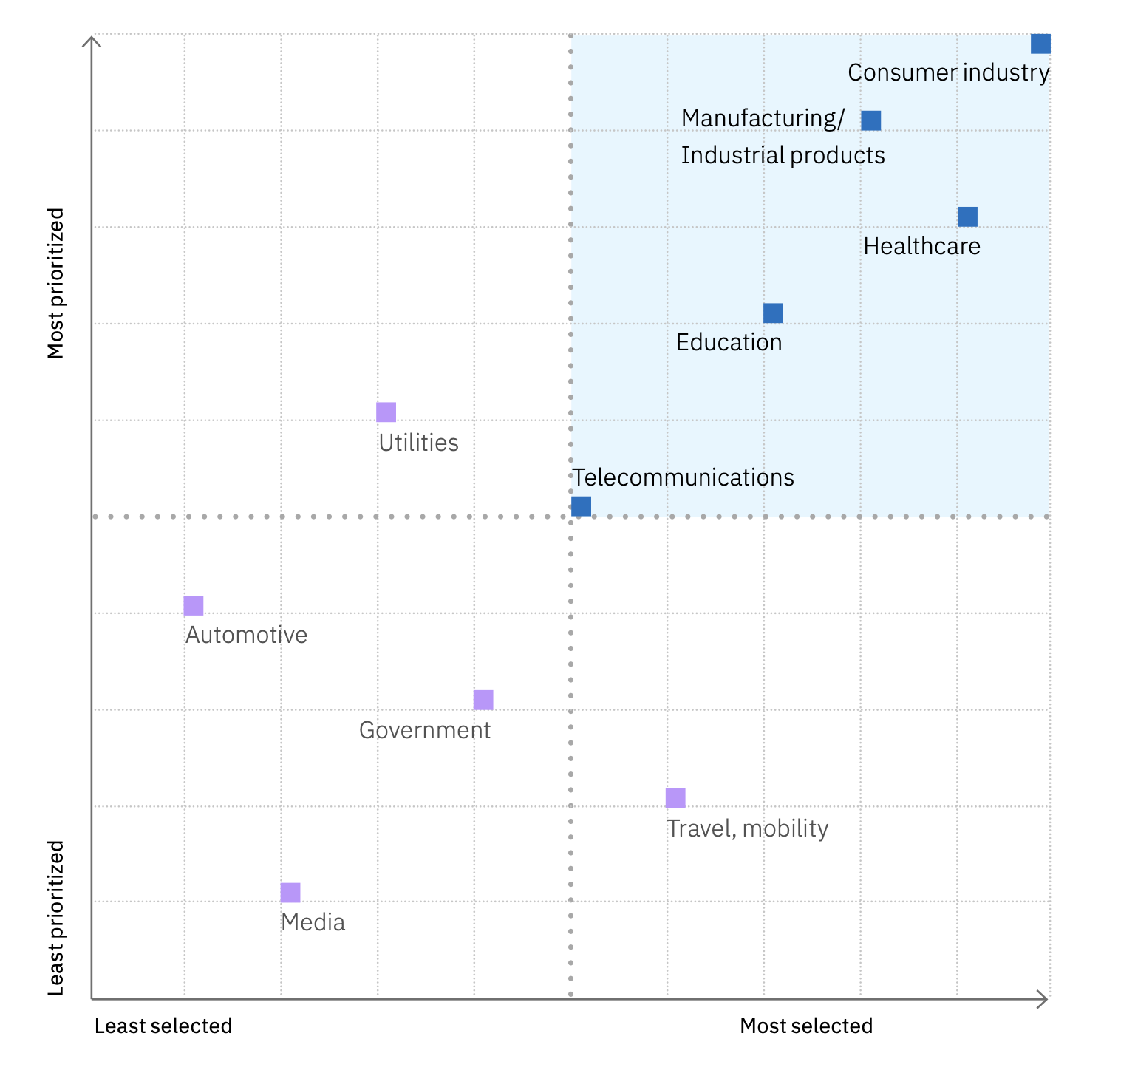
Back to contents
How financial institutions are entering into ecosystems?
Financial institutions are expanding into wider range of industries like consumer products, healthcare, education, and many others to embed financial services with APIs. However, incumbents are taking a two-pronged approach towards ecosystems and platform business models
Joining existing platform orchestrators to prevent commoditization and source insights to develop new products and services.
Creating their own interconnected ecosystems in specific markets, using their unique strengths to offer tailored services.
The role of open innovation:
Regulatory and customer pressure to improve financial inclusion and convenience are driving financial institutions towards partnerships and open innovation.
Enhanced customer experience, access to new markets and technologies, optimized costs, and improved competitiveness are a few benefits of open innovation.
Open banking is a safe, secure modular interaction framework that allow users to share their financial data with trusted third parties, will enable these ecosystems to succeed.
Recently, European union has proposed Third Payment Service Directive (PSD 3), that improves functioning of open banking (a form of open innovation) and enhances control to citizens over data access.¹
API Marketplaces, collaboration with fintech start-ups, and accelerator programs are few other ways through which financial institutions are leveraging open innovation.
Top 5 non-financial ecosystems that seem promising for financial institutions²
Open innovation & ecosystems
1
Consumer industry
2
Manufacturing/Industrial products
3
Healthcare
4
Education
5
Telecommunications
Related IBM publications for more insights:
Embedded finance: Creating the everywhere, everyday bank
Notes:
Appendices – Open Innovation and Ecosystems
Payment services: revised rules to improve consumer protection and competition in electronic payments. European Commission. 2023. https://ec.europa.eu/commission/presscorner/detail/en/qanda_23_3544
Ramamurthy, Shanker, John Duigenan, Paolo Sironi, Diane Connelly, and Connor Loessl. Embedded finance: Creating the everywhere, everyday bank. IBM. 2023. https://w3.ibm.com/services/lighthouse/spaces/view/banking-financial-markets/documents/206716?ref=206716_1246_File

Slide 29
Back to contents
Profitability and efficiency indicators
Return on Average Equity (ROAE %) measures performance based on the average shareholders’ equity. [Net Income / Average Equity Value between year start and end].
Cost Income Ratio (CIR %) measures a bank’s efficiency. [Operating Expense / Operating Income].
Net Interest Margin (NIM %) measures a bank profitability from credit operations (e.g., interest earned from loans and mortgages less interest paid to saving account holders). [Net Interest Income / Total Assets].
Market indicators
Price to Book Ratio (PBR) measures the market capitalization relative to book value. Firms with PBR much lower than 1 are typically distressed. [Stock Price per share / Book Value per share].
Regulatory indicators
Common Equity Tier 1 ratio (CET1 %) determine the ability to withstand financial distress measuring the amount of core equity assets (highest quality portion of Tier 1 capital, such as common shares and retained earnings). CET1 capital is meant to absorb losses immediately when they occur and must be higher than a minimum required. [Common Equity Tier 1 / RWA].
Liquidity Coverage Ratio (LCR %%) measures the proportion of highly liquid assets to ensure a bank’s ongoing ability to meet short-term obligations and ride out any short-term liquidity disruptions. LCR must be higher than 100% minimum, with a suitable buffer. [High Quality Liquid Assets / Total Net Cash Flow].
Loan to Deposit Ratio (LDR %) measures a bank’s overall liquidity. The ideal LDR is 80% to 90%. [Total Loans / Total Deposits].
KPIs & industry benchmarks
Key Performance Indicators (KPIs) are high level metrics used to gauge a quantifiable component of an organization’s performance that is of strategic importance and aligns with operational objectives.
Related IBM publications for more insights:
State of the union in banking
Notes:
Appendices – KPI & Industry Benchmarks
Metrics and benchmarks for retail banks. IBM. 2022. https://w3.ibm.com/services/lighthouse/spaces/view/banking-financial-markets/documents/206244?ref=206244_1246_File

Slide 30
Back to contents
 | Key Performance Indicators | Sample size | Median | Benchmark (80th percentile)
Cost and income | Cost-to-income ratio. | 714 | 40% | 35%
 | Annual non-interest expense per retail banking customer. | 714 | $435 | $150
Cost and income | Annual retail bank revenue (interest income plus fee income) per retail banking customer. | 714 | $705 | $2,062
 | Annual fee income per retail banking customer. | 714 | $205 | $706
Cost and income | Overall personnel costs for the business entity (including benefits) as a percentage of revenue. | 66 | 18% | 9%
Efficiency and effectiveness | Full time equivalents (FTEs) performing retail banking activities per billion US Dollars operating expense. | 714 | 7,407 | 3,835
 | Rate of employee turnover (voluntary or involuntary). | 96 | 17% | 11%
 | Retail banking customers per branch. | 570 | 10,785 | 30,061
 | Net Promotor Score (NPS) for customer experience. | 714 | 30 | 45
 | Self-service transactions as a percentage of all retail banking transactions. | 714 | 65% | 75%
 | Annual rate of growth in number of deposit accounts. | 714 | 3.5% | 4.1%
Efficiency and effectiveness | Fraudulent payments as a percentage of all payments. | 541 | 20% | 15%
 | Website new visitor conversion rate. | 55 | 6% | 10%
 | Percentage of the financial forecast that is created through touchless processing. | 47 | 30% | 30%
 | Annual savings (cost avoidance and cost takeout) achieved by procurement department as a percentage of annual spend. | 55 | 5% | 6%
 | Average minutes to resolution for high-severity incidents. | 188 | 20 | 15
 | Average number of defects identified in production per thousand lines of code. | 188 | 32 | 24
KPIs & industry benchmarks
Benchmarking allows organizations to know their standing relative to comparators and determines 'best in class’ performance.
Related IBM publications for more insights:
Metrics and benchmarks for retail banks
Benchmark Wizard: banking and financial markets
Benchmark is the top-performing 20th percentile for retail banks' scores in our database, in other words, 20% scored better than this value.
Notes:
Appendices – KPI & Industry Benchmarks
Metrics and benchmarks for retail banks. IBM. 2022. https://w3.ibm.com/services/lighthouse/spaces/view/banking-financial-markets/documents/206244?ref=206244_1246_File

Slide 31
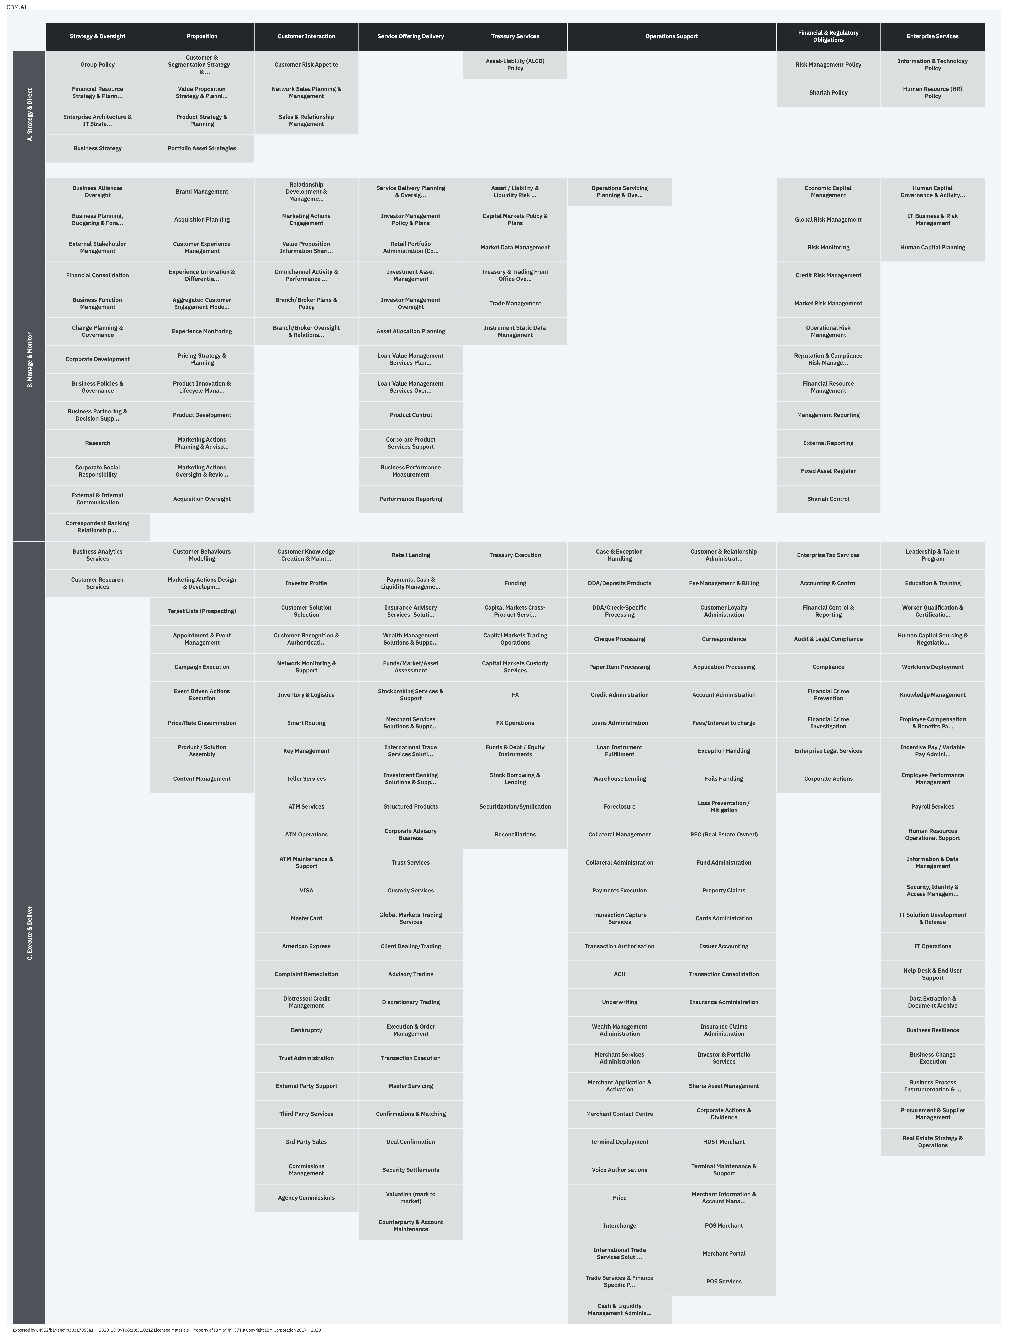
Back to contents
Component Business Model
Banking and financial markets organizations need to accelerate their business and sustainability journey.
Component Business Model serves as a catalyst for driving banking and financial markets transformation by providing insights into “where to take action, prioritize, and why”.
CBM is a framework designed to model and assess businesses, enabling the organization and categorization of various business activities into fundamental units known as "business components"¹
CBM makes clear how leadership run the business through an Enterprise-on-a-page structure.
CBM Map – full-service banking
Banking and Financial Markets
Notes:
Appendices – Component Business Model
Full-Service Banking Extended (3 accountability levels view). IBM. Accessed in October 2023. https://cbm-ai.wdc1a.cirrus.ibm.com/Library/repo:f29fa11b-7dfd-4329-9d04-9dcf9d6a898a

Slide 32

Educational Resources

Slide 33







Back to contents
Click on the images to open the studies
Thought leadership
Embedded finance: Creating the everywhere, everyday bank
Embedded finance: The voice of the makers
2023 Global Outlook for Banking and Financial Markets
Embedded finance is essential for modern banking strategies. Learn how financial institutions are boosting business performance on the platform economy.
Hear from experts and makers what opportunities embedded finance creates for banks, non-banking partners, and tech-forward competitors.
Banks and financial markets firms can expect “certain uncertainty” in 2023. What might an agile response look like this year?
Foundations of banking excellence
State of the union in Banking enablement deck
Security, the cost of data breaches, and AI for Banking and Financial Markets
Related IBM publications for more insights: IBV banking & financial markets industry page
Explore IBM and BIAN’s findings on how healthier financial institutions and banks accelerate digital transformation and digitalization.
Learn why organizations expect edge computing to improve operational responsiveness–and reduce operating costs.
CEOs of Banking and FM institutions define cyber risk as their top challenge

Slide 34
Back to contents
Supplementary resources
Learn and build your eminence
IBV banking and financial markets industry page - IBM Institute for Business Value - Thought leadership
IBM lighthouse banking and financial markets - Thought leadership, expertise, offerings, case studies & learning assets
Your Learning - For courses, certifications, resources on banking and financial markets
Content+ - Easy access to all IBM solution and offerings across industries
IBM Northernlight - For analyst, investment reports, whitepapers & external articles
Financial Services Industry seismic page - Discover technology use cases, industry strategy, recent wins, and curated IBM resources
IBM Consulting Strategy and Capabilities Deck: 2023 Edition – Latest market trends and IBM consulting priorities. Click on Contents page to navigate to industry strengths slides
Industry skills & badging roadmap - to build strong industry knowledge and skills.
Connect and build your personal brand
Banking CollaborationHUB workspace in Slack
Financial Markets CollaborationHUB workspace in Slack
IBM lighthouse banking and financial markets - Thought leadership, expertise, offerings, case studies & learning assets
Key Contacts – Banking and financial markets
Client facing links you can share
IBM banking and financial markets homepage - Organization level information on banking and financial markets solutions, insights and case studies
IBV banking and financial markets industry page - IBM Institute for Business Value - Thought leadership
IBM Blogs - Banking and Financial Services - Recent updates and quick reads on IBM’s contribution to banking and financial markets

Slide 35

References

Slide 36
References
Back to contents
Industry Overview
Industry Dynamics (continued)
2023 Chief Executive Officer Study. IBM. 2023. https://w3.ibm.com/services/lighthouse/spaces/view/banking-financial-markets/documents/203094?ref=203094_1246_File
Ibid
Ibid
Ibid
Ibid
2023 Chief Executive Officer Study. IBM. 2023. https://w3.ibm.com/services/lighthouse/spaces/view/banking-financial-markets/documents/203094?ref=203094_1246_File
Ibid
Ibid
Industry Dynamics
Why Is Inflation So High Right Now? Entrepreneur. 2023. https://entm.ag/cpZUUh
Tepper, Taylor and Benjamin Curry. Federal Funds Rate History 1990 to 2023. Forbes. 2023. https://www.forbes.com/advisor/investing/fed-funds-rate-history/
Ramamurthy, Shanker, John Duigenan, Paolo Sironi, Diane Connelly, and Connor Loessl. 2023 Global Outlook for Banking and Financial Markets. IBM. 2023. https://w3.ibm.com/services/lighthouse/documents/195084?ref=195084_1246_File
Duggan, Wayne and Michael Adams. September Fed Meeting: Interest Rates Are Put On Hold, One More Rate Hike Likely. Forbes. 2023. https://www.forbes.com/advisor/investing/fomc-meeting-federal-reserve/
Global Financial Stability Report. International Monetary Fund. 2023. https://www.imf.org/en/Publications/GFSR/Issues/2023/04/11/global-financial-stability-report-april-2023
Ibid
Ibid
Ramamurthy , Shanker, John Duigenan, Paolo Sironi, Diane Connelly, and Connor Loessl. Embedded finance: Creating the everywhere, everyday bank. IBM. 2023. https://w3.ibm.com/services/lighthouse/spaces/view/banking-financial-markets/documents/206716?ref=206716_1246_File
Ibid
Industry Trends
Ramamurthy, Shanker, John Duigenan, Paolo Sironi, Diane Connelly, and Connor Loessl. 2023 Global Outlook for Banking and Financial Markets. IBM. 2023. https://w3.ibm.com/services/lighthouse/documents/195084?ref=195084_1246_File
Ramamurthy, Shanker, John Duigenan, Paolo Sironi, Diane Connelly, and Connor Loessl. Embedded finance: Creating the everywhere, everyday bank. IBM. 2023. https://w3.ibm.com/services/lighthouse/spaces/view/banking-financial-markets/documents/206716?ref=206716_1246_File
Ibid
Ibid
Ibid
Ibid
Ibid
Ibid

Slide 37
References
Back to contents
Industry Trends (continued)
Technologies (continued)
Ibid
Ibid
2023 Chief Executive Officer Study. IBM. 2023. https://w3.ibm.com/services/lighthouse/spaces/view/banking-financial-markets/documents/203094?ref=203094_1246_File
Green Investment – the Uncertain Future of Sustainable Bonds in 2023. Bloomberg. 2023. https://www.bloomberg.com/professional/blog/webinar/green-investment-is-the-greenium-alive-and-well-in-2023/
Pathways in transformative sustainability: banking CEOs own their impact. IBM. 2022. https://www.ibm.com/thought-leadership/institute-business-value/en-us/blog/pathways-sustainability-banking-ceos
ESG reporting and performance (2023). IBM. 2023. https://w3.ibm.com/services/bcs/competency/benchmarking/wizard/protect/bmwizard.wss/showResultsPage2?functionId=53651
Ibid
Ibid
Chief data officer study. IBM. 2023. https://w3.ibm.com/services/bcs/competency/benchmarking/wizard/protect/bmwizard.wss/showCoverPage2?pageType=2&refId=53558
The Benefits of the Blockchain in Financial Services: Modern Solutions and Examples. Coinpedia. 2023. https://coinpedia.org/guest-post/benefits-of-blockchain-in-financial-services-modern-solutions-and-examples/
Swift unlocks potential of tokenisation with successful blockchain experiments. SWIFT. 2023. https://www.swift.com/news-events/press-releases/swift-unlocks-potential-tokenisation-successful-blockchain-experiments
6 Ways the IoT is Revolutionizing the Banking and Investment Sector. AIIOT. 2023. https://www.aiiottalk.com/iot-revolutionizing-the-banking-and-investment-sector/
2023 Chief Executive Officer Study. IBM. 2023. https://w3.ibm.com/services/lighthouse/spaces/view/banking-financial-markets/documents/203094?ref=203094_1246_File
Egger, Daniel, Paolo Sironi, Richard Warrick, and Stefan Worner. Exploring quantum computing use cases for financial services: Applying emerging quantum technology to financial problems. IBM. 2019. https://w3.ibm.com/services/lighthouse/documents/145398?ref=145398_1246_File
Quantum use case. IBM. 2023. https://ibm.seismic.com/Link/Content/DC9dpHCVH3mGpGcDcb8h9G3W9VJd
Quantum readiness. IBM. 2023. https://w3.ibm.com/services/bcs/competency/benchmarking/wizard/protect/bmwizard.wss/showCoverPage2?pageType=2&refId=54250
Ibid
Ibid
Ibid
Ibid
Ibid
Technologies
Ramamurthy, Shanker, John Duigenan, Paolo Sironi, and Diane Connelly. Foundations of banking excellence: Practices and priorities to accelerate digital transformation. IBM. 2022. https://w3.ibm.com/services/lighthouse/spaces/view/banking-financial-markets/documents/190607?ref=190607_1246_File
Ibid
Ibid
Ibid

Slide 38
References
Back to contents
Appendices – Generative AI
Appendices – Cybersecurity
Generative AI: “State of the Enterprise Market”: Banking and Financial Markets. IBM. 2023. https://w3.ibm.com/services/lighthouse/spaces/view/banking-financial-markets/documents/204579?ref=204579_1246_File
Maufe, Zac and Toby Brown. Five generative AI use cases for the financial services industry. Google. 2023. https://cloud.google.com/blog/topics/financial-services/five-generative-ai-use-cases-financial-services-industry
Borden, Bill. The era of generative AI: Driving transformation in banking. Microsoft. 2023. https://www.microsoft.com/en-us/industry/blog/financial-services/2023/05/04/the-era-of-generative-ai-driving-transformation-in-banking/
Falk, Ruben. The Next Frontier: Generative AI for Financial Services. Amazon. 2023. https://aws.amazon.com/blogs/industries/the-next-frontier-generative-ai-for-financial-services/
Ibid
Sironi, Paolo and Diane Connelly. Security, the cost of data breaches, and AI for Banking and Financial Markets. IBM. 2022. https://w3.ibm.com/services/lighthouse/spaces/view/banking-financial-markets/documents/188619?ref=188619_1246_File
Ramamurthy, Shanker, John Duigenan, Paolo Sironi, and Diane Connelly. Foundations of banking excellence: Practices and priorities to accelerate digital transformation. IBM. 2022. https://w3.ibm.com/services/lighthouse/spaces/view/banking-financial-markets/documents/190607?ref=190607_1246_File
Appendices – Open Innovation and Ecosystems
Payment services: revised rules to improve consumer protection and competition in electronic payments. European Commission. 2023. https://ec.europa.eu/commission/presscorner/detail/en/qanda_23_3544
Ramamurthy, Shanker, John Duigenan, Paolo Sironi, Diane Connelly, and Connor Loessl. Embedded finance: Creating the everywhere, everyday bank. IBM. 2023. https://w3.ibm.com/services/lighthouse/spaces/view/banking-financial-markets/documents/206716?ref=206716_1246_File
Appendices – Hybrid Cloud
IBM transformation index: state of cloud. IBM. 2022. https://w3.ibm.com/services/bcs/competency/benchmarking/wizard/protect/bmwizard.wss/showCoverPage2?pageType=2&refId=53450
Ramamurthy, Shanker, John Duigenan, Paolo Sironi, and Diane Connelly. Foundations of banking excellence: Practices and priorities to accelerate digital transformation. IBM. 2022. https://w3.ibm.com/services/lighthouse/spaces/view/banking-financial-markets/documents/190607?ref=190607_1246_File
Ibid
Appendices – Component Business Model
Full-Service Banking Extended (3 accountability levels view). IBM. Accessed in October 2023. https://cbm-ai.wdc1a.cirrus.ibm.com/Library/repo:f29fa11b-7dfd-4329-9d04-9dcf9d6a898a
Appendices – KPI & Industry Benchmarks
Metrics and benchmarks for retail banks. IBM. 2022. https://w3.ibm.com/services/lighthouse/spaces/view/banking-financial-markets/documents/206244?ref=206244_1246_File

